Slide 1
This slide is a supplement to A Geography of Russia and Its Neighbors, Second Edition by Mikhail S. Blinnikov. Copyright © 2021 The Guilford Press.
Chapter 14. Religion, Diet, and Dress
Why important?
Distribution of religions in Northern Eurasia (ethnic and universalizing)
origin and diffusion
Religion and organization of space
sacred structures
sacred places
Territorial conflicts – religious or political?
Why important?
Intertwined with culture and history (tourism)
Major driving factor in settlement
Byzantium connection
monks of the Russian North
Economic geography
Labor in monasteries, feast and fast cycles
Major factor in the organization of space
internal – izba and khram
external – cemeteries, city layout

Slide 2
This slide is a supplement to A Geography of Russia and Its Neighbors, Second Edition by Mikhail S. Blinnikov. Copyright © 2021 The Guilford Press.
Church and politics in recent times
Communists hated religion as it was competing for the minds of people
1000s of churches and mosques closed and even destroyed
Most bishops and many priests executed in 1920–1938
Church was allowed to start slowly rebuild in 1943 as the war was raging on
Since 1988, a lot more churches were allowed to reopen
100s of monasteries restored
Main religions of N. Eurasia
Orthodox Christianity (Russia, Ukraine, Belarus, Moldova, Georgia)
Islam (Volga and N. Caucasus regions in Russia, Central Asia – mostly Sunnis and Sufis, Azerbaijan – Shi’a)
Other traditional religions
Roman Catholic Church (Lithuania, Ukraine, Belarus)
Lutheran (Estonia & Latvia)
Armenian Christian Apostolic Church (Armenia)
Judaism (old urban centers, villages in Ukraine & Belarus)
Buddhism (Kalmykia and Buryatia in Russia)
Burkhanism (Altay Republic)
Shamanism and animism (North and most of Siberia)
Imported religions; Adventists, Mormons, JW, evangelicals, etc.

Slide 3
This slide is a supplement to A Geography of Russia and Its Neighbors, Second Edition by Mikhail S. Blinnikov. Copyright © 2021 The Guilford Press.
Diffusion of main religions into Northern Eurasia(map)
Christianity mainly from the south (Greeks in Byzantium)
Islam mainly from Baghdad (Sunni) and from Persia (Shia)
Judaism from central Europe (Poland, Austro-Hungary)
Buddhism – from Asia into Kalmykia and Buryatiya
Orthodox Church is one of three main divisions within Christianity
www.orthodoxinfo.com
mospat.ru
oca.org
Orthodox Church – one with Roman Catholic Church until 1054 AD
7 councils 4th–9th centuries
“One, Holy, Catholic and Apostolic” – same as Catholics say
Disagreement about the role of the Pope and some religious teachings led to split
Greek, Antiochian, Alexandrian, Jerusalem, Georgian, Serbian, Russian – are all parts of the same church, led by local bishops (Patriarchs)
Traditional and very spiritual
Male dominated
Communal

Slide 4
This slide is a supplement to A Geography of Russia and Its Neighbors, Second Edition by Mikhail S. Blinnikov. Copyright © 2021 The Guilford Press.
Russian Orthodox Church
988 AD – baptism of Rus under St. Vladimir of Kiev
Kiev Caves Monastery (Lavra) is the oldest and most famous
St. Sergius of Radonezh (14th century) – near Moscow established Holy Trinity Monastery, now is the spiritual center of Moscow Patriarchate
Russia viewed itself as “3rd Rome,” an heir to the late Byzantine Roman Empire
monastic exodus and missions to the North and East in 14–19 centuries led to development of Siberia
Sacred Structures and Sacred Space
Organization of cities and villages centered on a temple (church or monastery)
Church buildings: cathedrals, parish churches (or Храмы)
Monasteries played a huge role in medieval Russia
Suzdal (population 12,000) has 4 monasteries, Rostov (pop. 20,000) has 5
Roadside shrines as pilgrimage markers
Veneration of holy objects: springs, icons, relics, etc. and tradition of pilgrimage

Slide 5
This slide is a supplement to A Geography of Russia and Its Neighbors, Second Edition by Mikhail S. Blinnikov. Copyright © 2021 The Guilford Press.
Christ the Savior Cathedral – the biggest temple, destroyed in 1931 by Communists, rebuilt in late 20th century on the orders and with financial support of the mayor of Moscow Yu. Luzhkov
Internal space: every house had a beautiful corner with icons as a shrine (on the right side, as you enter)
Orthodox Church Plan (see pic in the textbook)
Enter from the West
Face East when praying
Standing, sitting is not allowed, generally
Services can last many hours
Iconostasis as a wall of icons separating the altar from the worship space
Orthodox Monasteries
Egyptian and Palestinian were the earliest in 4th century-> Byzantine (8–14th century) and Western in Italy and France
Kiev Caves and Valaam – two oldest monasteries, about 1000 years each
as many as 1000 existed before Revolution, 100s exist today
Monks played a great role in settling Russian North and Siberia

Slide 6
This slide is a supplement to A Geography of Russia and Its Neighbors, Second Edition by Mikhail S. Blinnikov. Copyright © 2021 The Guilford Press.
Total number of monastics in Russia is in the low 10,000, there are more nuns than monks
Optina Monastery near Kozelsk in Kaluga Oblast – a famous site beloved by writers
Religious landscapes
Orientation of cities
Churches
Roadside shrines
Holy wells
Cemeteries
Other religions
Catholic church + Uniates (Byzantine catholic)
Lithuania, W. Ukraine, Belarus
Protestant churches
Lutheran – Estonia, Latvia
Local Evangelical churches
“Imported” churches (e.g., Mormons)
Islam – Volga region, N. Caucasus, Central Asia
Judaism – declining (biggest cities)
Buddhism
Animist religions of the North

Slide 7
This slide is a supplement to A Geography of Russia and Its Neighbors, Second Edition by Mikhail S. Blinnikov. Copyright © 2021 The Guilford Press.
Kasimov, Ryazan Oblast about 300 km SE of Moscow has mosques and churches
Bolgar, Tatarstan – the spiritual center for the Volga Tatars
Temple of all religions near Kazan – a syncretic project by an enthusiast, who wanted to honor all religions
Non-religious people
Impacts of 70 years of official atheism
More than half have no regular church life
70% baptized, but only 8% attend church monthly or so (even fewer weekly)
Social impact on family life
Church is a powerful institution and is viewed with suspicion by some
Vacuum can be filled with radical or alternative viewpoints
Conflicts where religion may have played a role
Uniate vs. Orthodox squabbles in Ukraine
Chechnya and Dagestan – rising Islamism in 1990s and open wars in 1993–1996 and 1999–2005
Ossetin-Ingush conflict in 1990s
Armenian-Azeri conflict over control of Nagorno-Karabakh region
Abkhaz-Georgian conflict in the late 1980s

Slide 8
This slide is a supplement to A Geography of Russia and Its Neighbors, Second Edition by Mikhail S. Blinnikov. Copyright © 2021 The Guilford Press.
However, some of the worst conflicts in recent times have been between members of the same religion (Donbass, South Ossetiya)
Diet and dress
Diet is heavy on northern grains (rye, oats, barley) and dairy products
Potatoes became very important since their introduction in the 18th century
Meat – mainly pork, beef and chicken, some lamb in the South and the mountains
Periods of fasting according to Orthodox Church cover about half of all days in the year
Vegetarian with fish products, sometimes vegan
Three meals per day
Some favorite foods (check out any Russian restaurant menu)
Borscht
Pelmeni
Pirogi
Caviar for special occasions
Pickled items (herring, cabbage)
Cheese and hard salami

Slide 9
This slide is a supplement to A Geography of Russia and Its Neighbors, Second Edition by Mikhail S. Blinnikov. Copyright © 2021 The Guilford Press.
Drinks – kvas, black tea, vodka
Dress
Basically European in style
Very warm for winter required
Natural furs are still worn by some
A lot of cheap imports from China
Low domestic production
Adaptation to hot summers in the south (head wraps, hats)

Slide 10
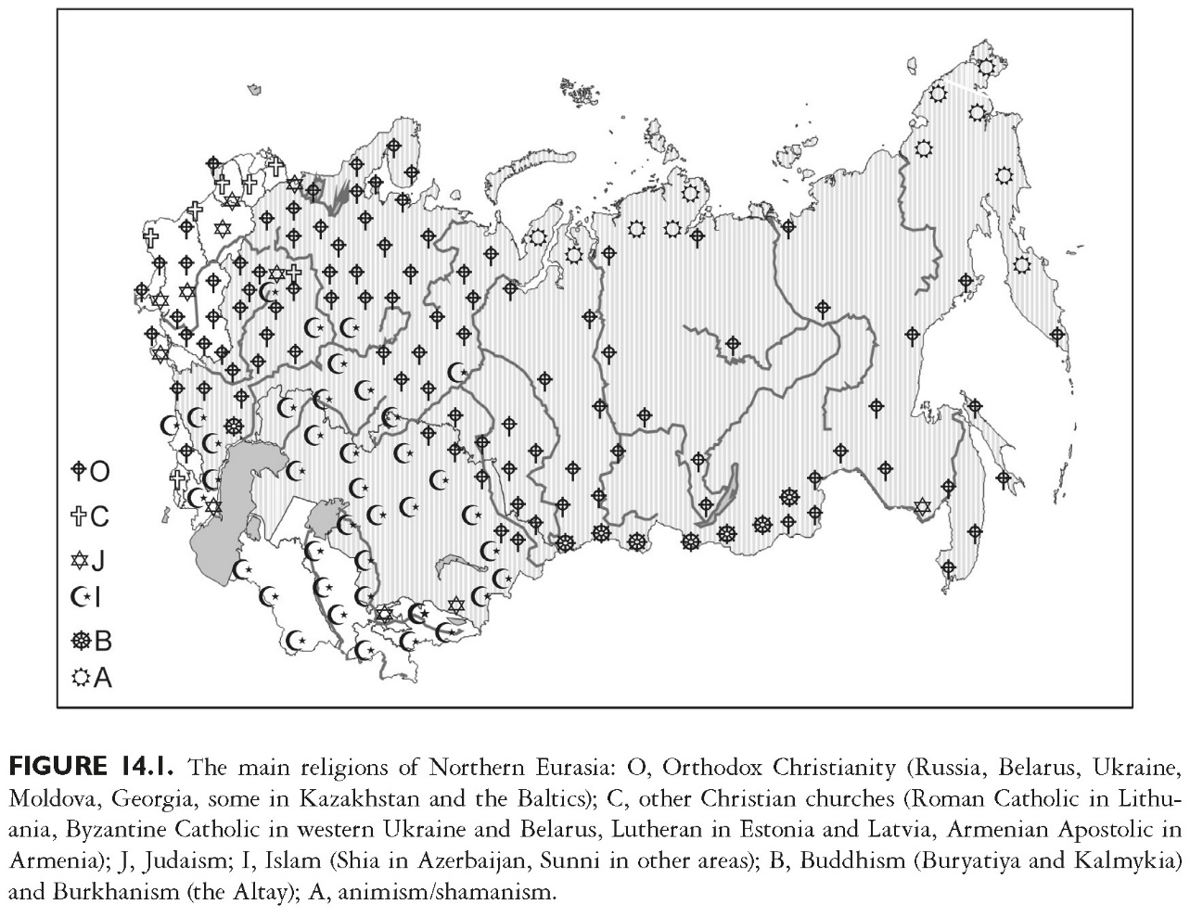
This slide is a supplement to A Geography of Russia and Its Neighbors, Second Edition by Mikhail S. Blinnikov. Copyright © 2021 The Guilford Press.

Slide 11
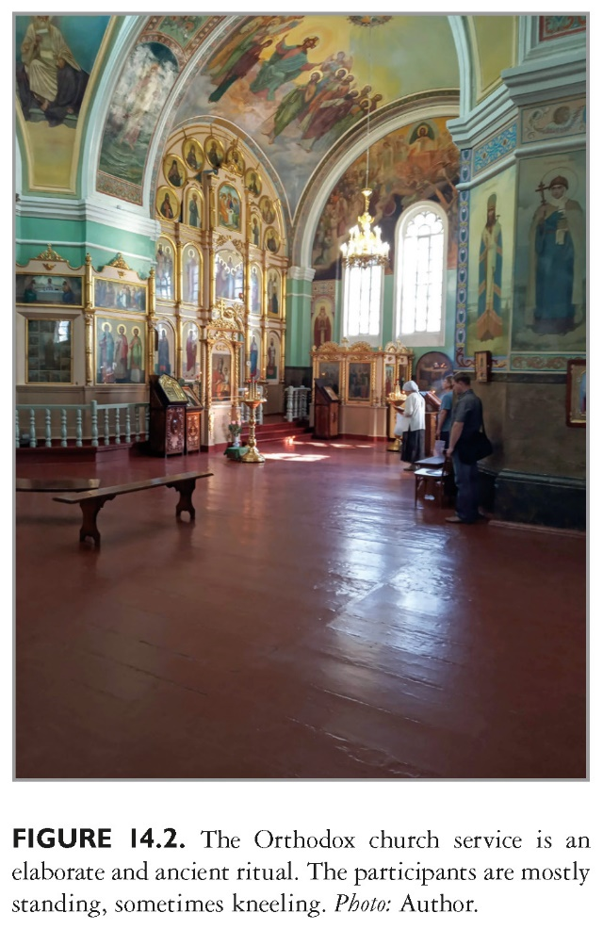
This slide is a supplement to A Geography of Russia and Its Neighbors, Second Edition by Mikhail S. Blinnikov. Copyright © 2021 The Guilford Press.

Slide 12
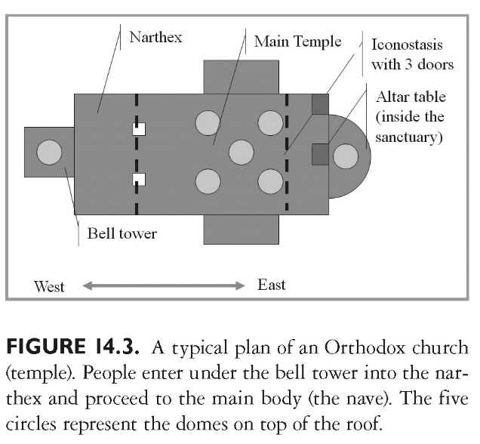
This slide is a supplement to A Geography of Russia and Its Neighbors, Second Edition by Mikhail S. Blinnikov. Copyright © 2021 The Guilford Press.

Slide 13
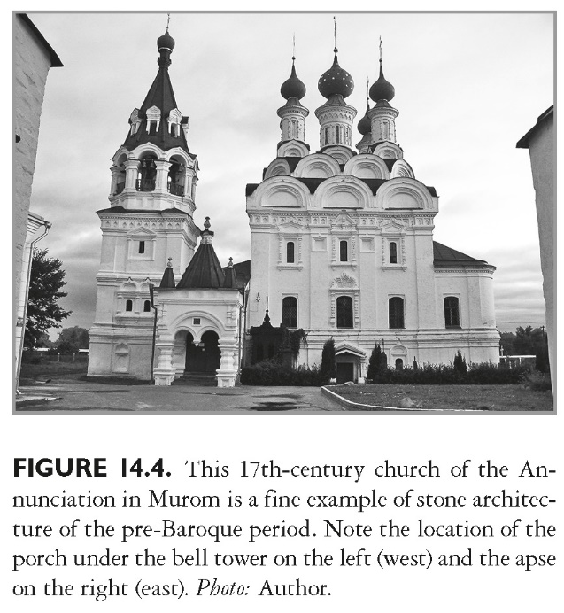
This slide is a supplement to A Geography of Russia and Its Neighbors, Second Edition by Mikhail S. Blinnikov. Copyright © 2021 The Guilford Press.

Slide 14
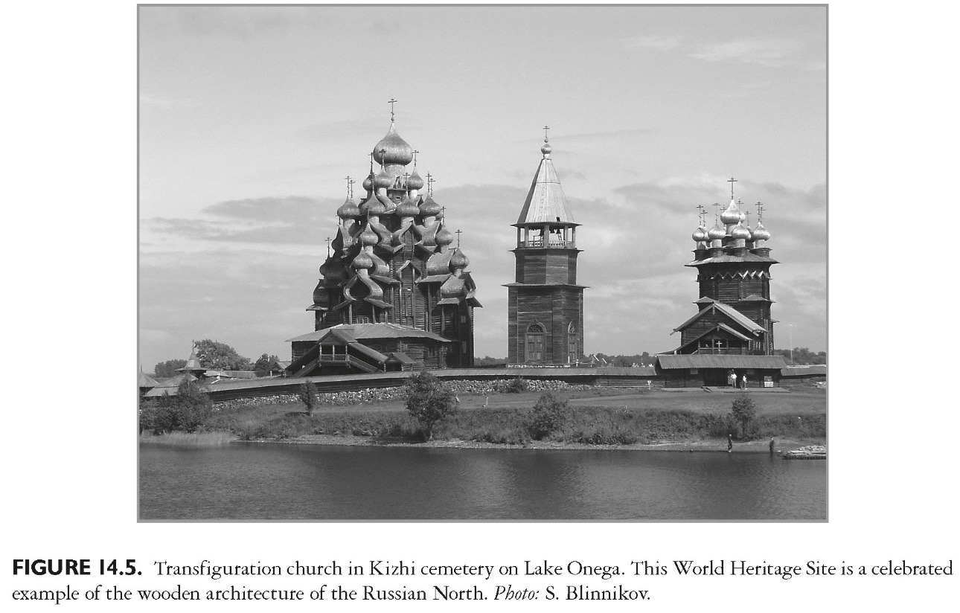
This slide is a supplement to A Geography of Russia and Its Neighbors, Second Edition by Mikhail S. Blinnikov. Copyright © 2021 The Guilford Press.

Slide 15
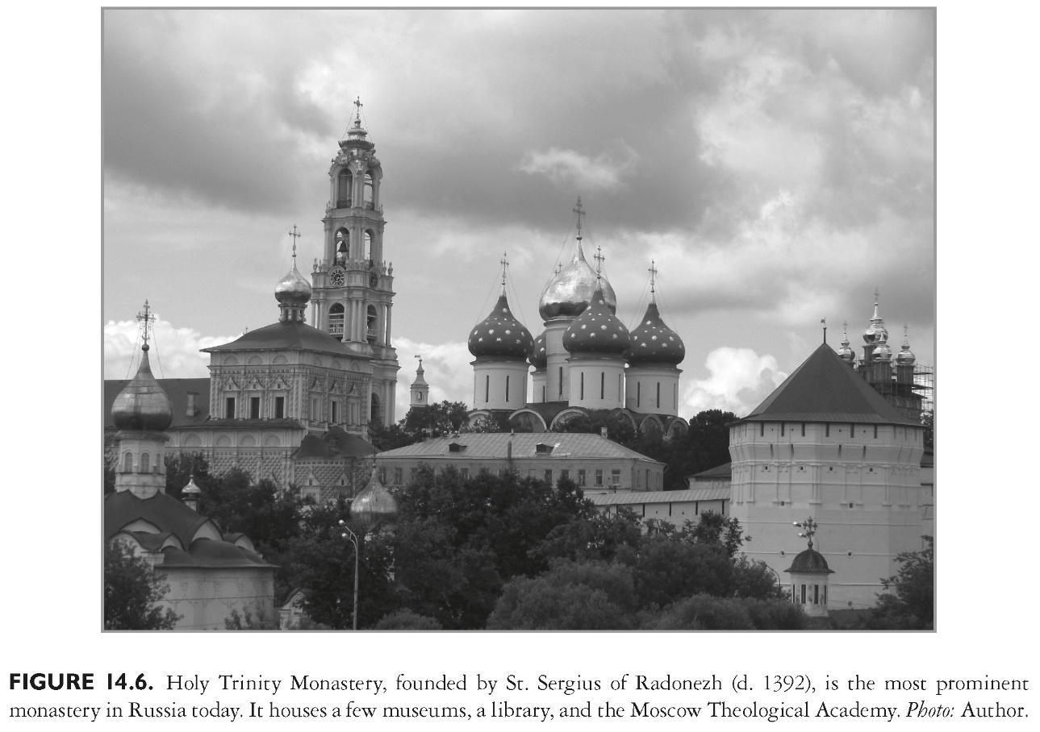
This slide is a supplement to A Geography of Russia and Its Neighbors, Second Edition by Mikhail S. Blinnikov. Copyright © 2021 The Guilford Press.

Slide 16
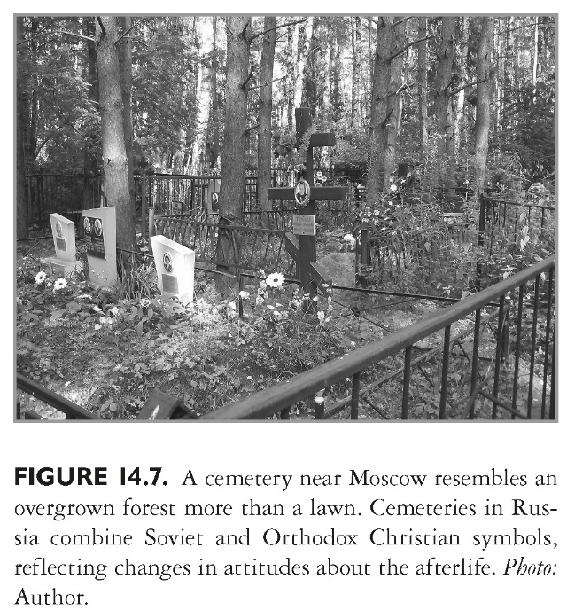
This slide is a supplement to A Geography of Russia and Its Neighbors, Second Edition by Mikhail S. Blinnikov. Copyright © 2021 The Guilford Press.

Slide 17
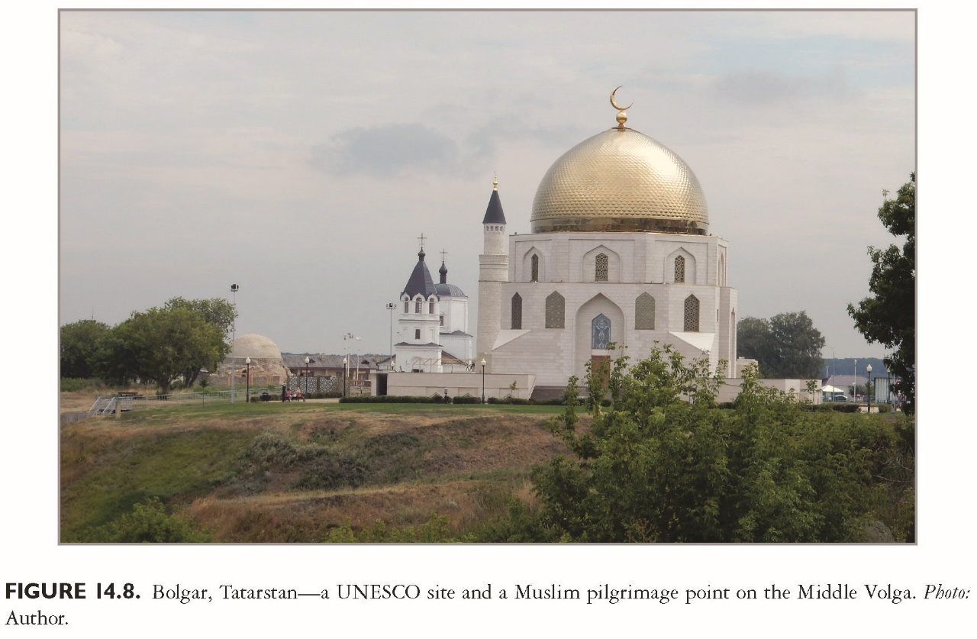
This slide is a supplement to A Geography of Russia and Its Neighbors, Second Edition by Mikhail S. Blinnikov. Copyright © 2021 The Guilford Press.

Slide 18
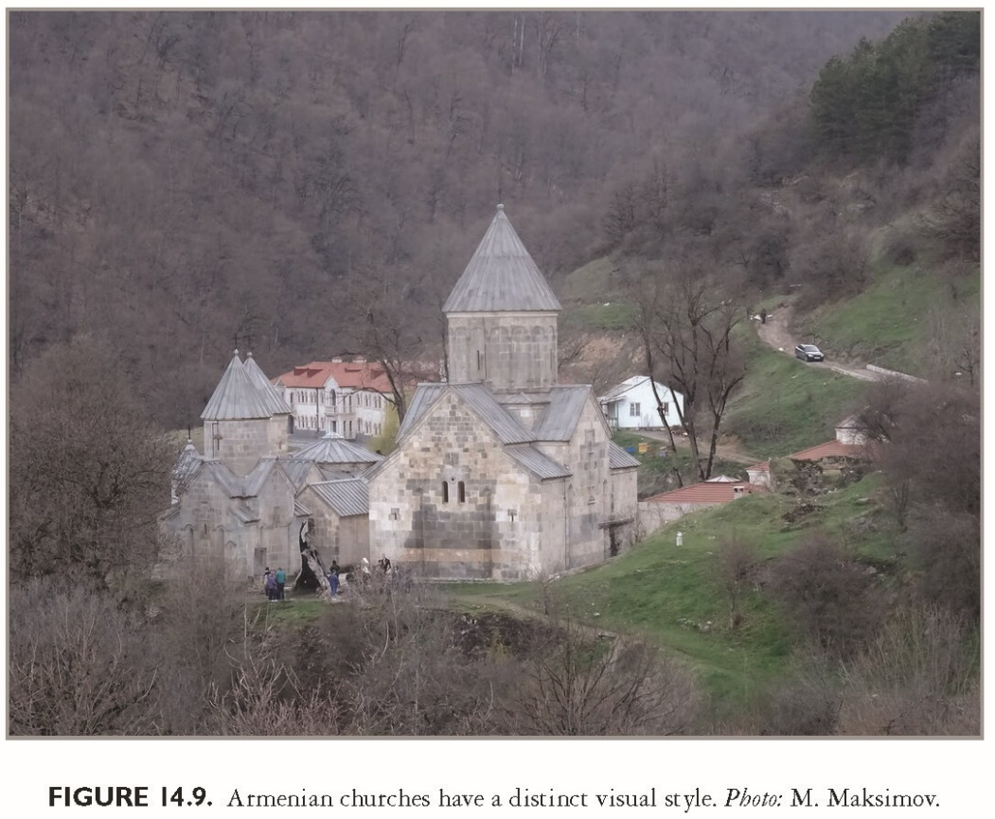
This slide is a supplement to A Geography of Russia and Its Neighbors, Second Edition by Mikhail S. Blinnikov. Copyright © 2021 The Guilford Press.

Slide 19
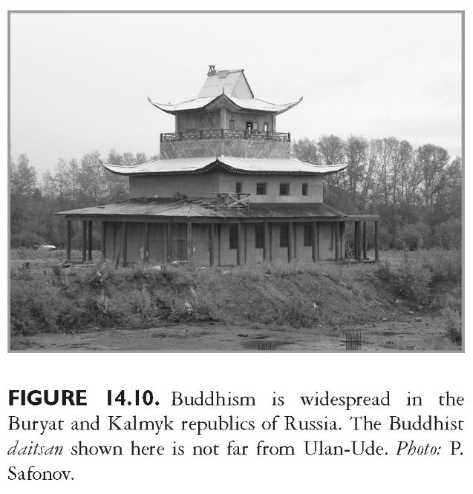
This slide is a supplement to A Geography of Russia and Its Neighbors, Second Edition by Mikhail S. Blinnikov. Copyright © 2021 The Guilford Press.

Slide 20
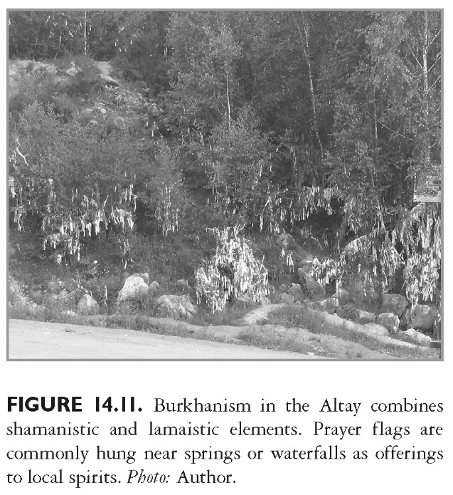
This slide is a supplement to A Geography of Russia and Its Neighbors, Second Edition by Mikhail S. Blinnikov. Copyright © 2021 The Guilford Press.

Slide 21
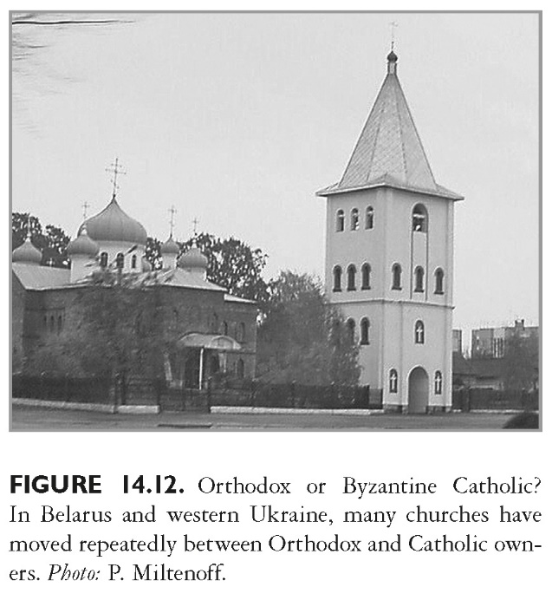
This slide is a supplement to A Geography of Russia and Its Neighbors, Second Edition by Mikhail S. Blinnikov. Copyright © 2021 The Guilford Press.

Slide 22
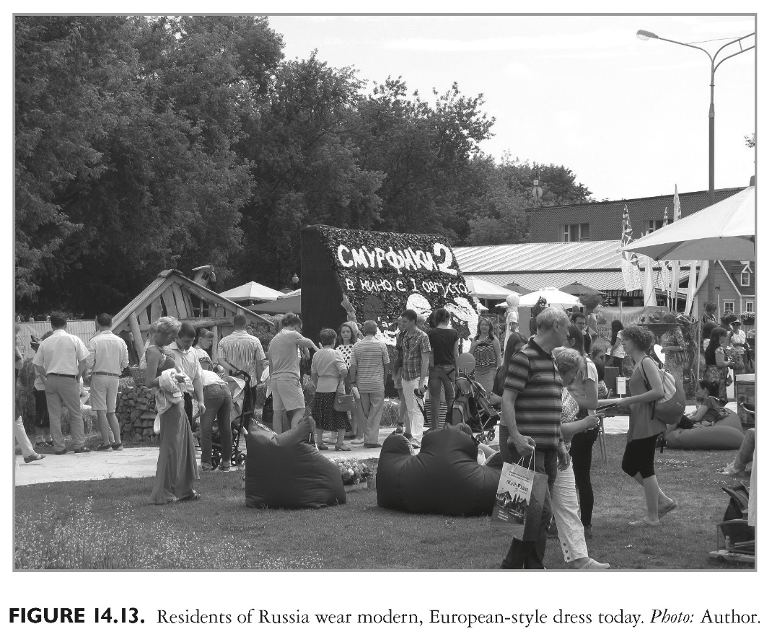
This slide is a supplement to A Geography of Russia and Its Neighbors, Second Edition by Mikhail S. Blinnikov. Copyright © 2021 The Guilford Press.

Slide 23
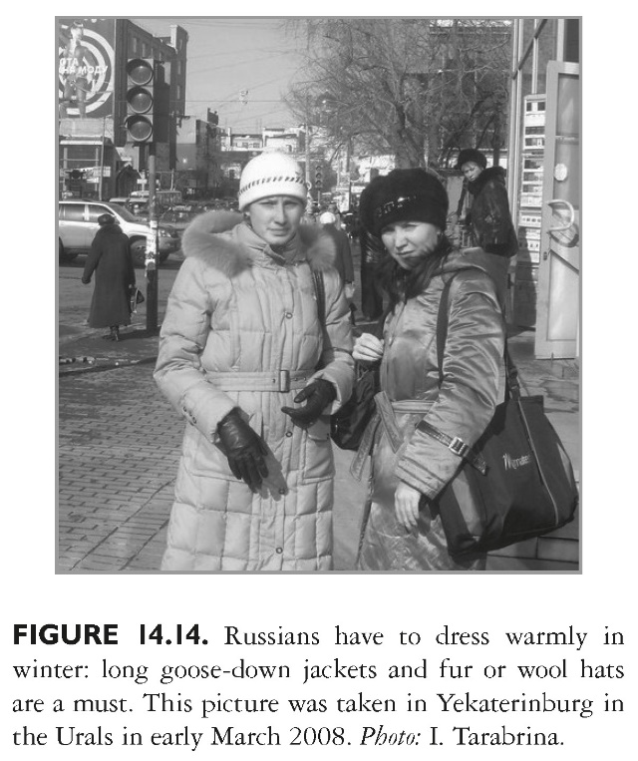
This slide is a supplement to A Geography of Russia and Its Neighbors, Second Edition by Mikhail S. Blinnikov. Copyright © 2021 The Guilford Press.

Slide 24
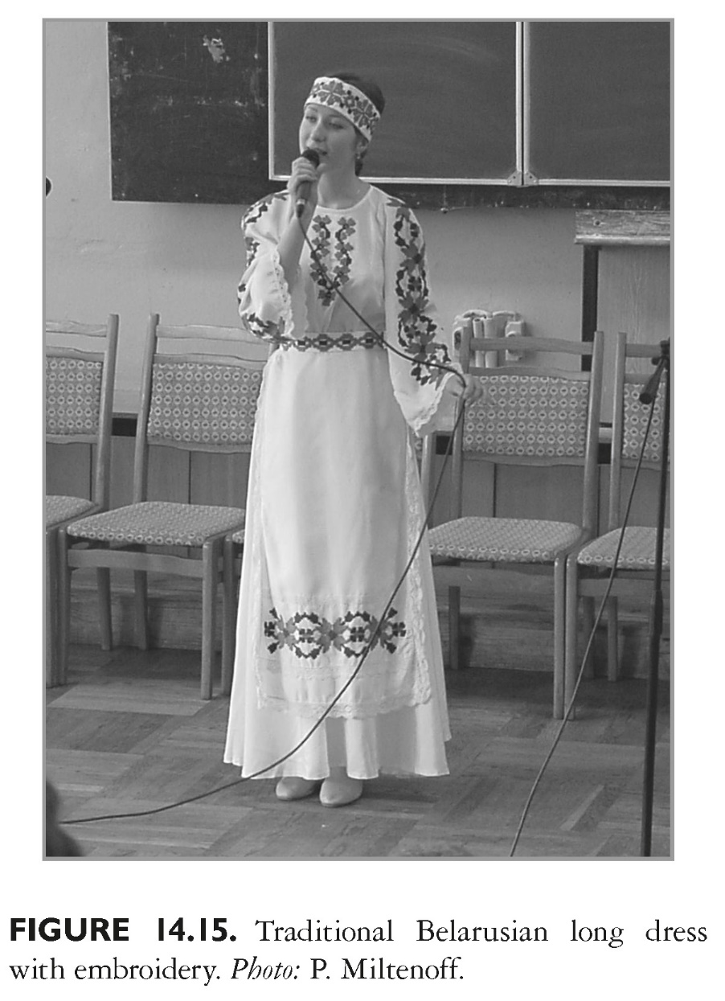
This slide is a supplement to A Geography of Russia and Its Neighbors, Second Edition by Mikhail S. Blinnikov. Copyright © 2021 The Guilford Press.

Slide 25
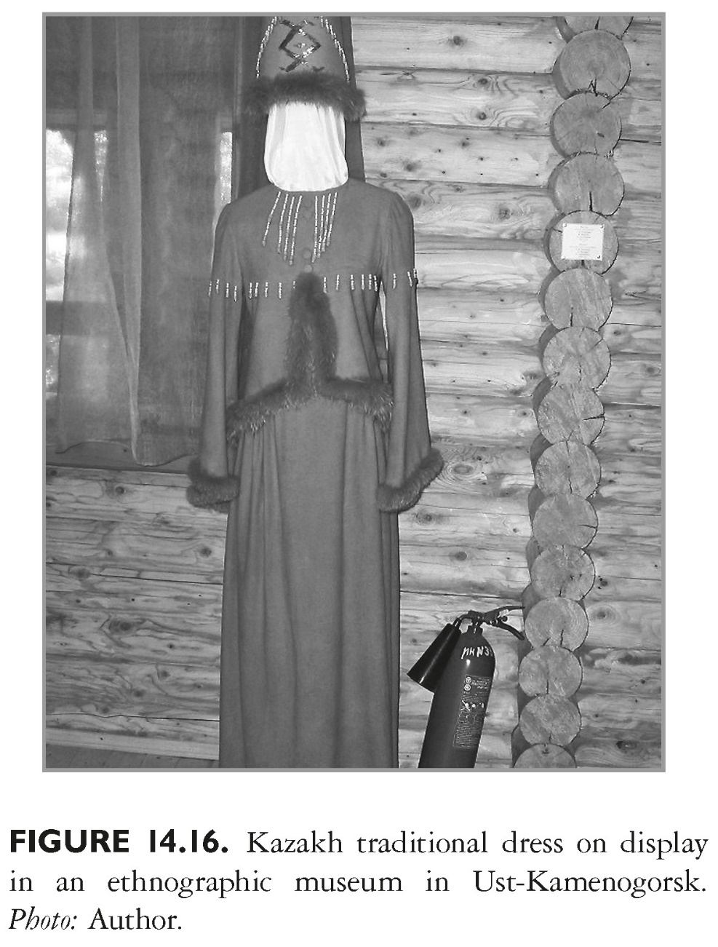
This slide is a supplement to A Geography of Russia and Its Neighbors, Second Edition by Mikhail S. Blinnikov. Copyright © 2021 The Guilford Press.

