Slide 1
This slide is a supplement to A Geography of Russia and Its Neighbors, Second Edition by Mikhail S. Blinnikov. Copyright © 2021 The Guilford Press.
Chapter 18. Heavy Military–Industrial Complex
GDP $4 trillion PPP in 2017 – 6th biggest (<Germany, >Indonesia)
Per capita $27,900 (<Malaysia), >Greece) – 71st out of 228 economies
GDP by sector Russia USA
Agriculture 5% 1%
Industry 32% 19%
Services 62% 80%
Income inequality very similar to the USA (richest 10% control 42% of consumption, poorest 10%–6%); unemployment rate is 5.5%, there is severe underemployment
Public debt is 12% of GDP (USA 77%, EU 89%, Japan 224%!)
Industry still severely skewed towards extractive industries (oil, gas, metals, timber), military equipment and heavy machinery production
Shedding of obsolete enterprises and military conversion
Also strong growth in communications, food processing, construction, and publishing

Slide 2
This slide is a supplement to A Geography of Russia and Its Neighbors, Second Edition by Mikhail S. Blinnikov. Copyright © 2021 The Guilford Press.
Russian industry composition (%)
 | 1992 | 2004
Fossil fuels | 14 | 17
Electric energy | 8.1 | 7.6
Iron and steel metals | 6.7 | 8.2
Non-ferrous metals | 7.3 | 10.3
Machine building | 24 | 22
Chemical | 6.4 | 7.2
Light industry | 5 | 1.4
Food industry | 14 | 15

Slide 3
This slide is a supplement to A Geography of Russia and Its Neighbors, Second Edition by Mikhail S. Blinnikov. Copyright © 2021 The Guilford Press.
Russia’s top companies in 2016 by overall revenue
Gazprom (gas)
Lukoil (oil)
Rosneft (oil)
Sberbank (bank)
RZD (railroads)
VTB (bank)
Surgutneftegaz (oil)
Magnit (retail)
Transneft (oil pipelines)
X5 (retail)
InterRAO
Russian grid
AFK Systema
Megapolis
Tatneft (oil)
Evraz (metals)
Rusal (metals)
Bahneft (oil)
Nornickel (metals)
NLMK (metals)

Slide 4
This slide is a supplement to A Geography of Russia and Its Neighbors, Second Edition by Mikhail S. Blinnikov. Copyright © 2021 The Guilford Press.
USA top companies in 2016 by overall revenue
Walmart (retail)
Berkshire Hathaway (many)
Apple (electronics)
Exxon Mobil (oil)
McKesson (healthcare)
United Health Group (healthcare)
CVS Health (pharma/healthcare)
GM (cars)
AT&T (telecom)
Ford (cars)
AmerisourceBergen (pharma)
Amazon (online retail)
GE (industrial/financial)
Verizon (telecom)
Cardinal Health (healthcare)

Slide 5
This slide is a supplement to A Geography of Russia and Its Neighbors, Second Edition by Mikhail S. Blinnikov. Copyright © 2021 The Guilford Press.
Metals
High concentration of capital, a few huge companies (all – old Soviet factories, now remodeled, none are really new)
Most in the Urals and the European part of the country
Steel: Severstal in Cherepovets, Evraz in the Urals, Magnitogorsk steel combine, Novolipetsk steel combine
Aluminum: the Yenisei basin (Rusal)
Nickel, copper, platinum: Nornickel in Norilsk
All owners of these enterprises are oligarchs and dollar billionaires, each company employs 10,000s of people and runs a few mono-cities each
MMK picture from the early 1930s when the Soviet Union built the iron smelter here (this was actually an American plant based on Gary, Indiana US Steel prototype that the Soviet Union basically purchased) (photo)
Oskemen, KZ was a major producer of non-ferrous metals in the Soviet Union
Oskemen streets look nice, but smog is common on most days of the year (photo)
Machine building is still important for Russia, although a lot less is made now

Slide 6
This slide is a supplement to A Geography of Russia and Its Neighbors, Second Edition by Mikhail S. Blinnikov. Copyright © 2021 The Guilford Press.
Transportation machinery is particularly important, some plants make both weapons (tanks) and railroad cars, for example Uralvagonzavod in Nizhniy Tagil (photo)
Military-industrial complex is mainly concentrated around Moscow, the Volga, and in the Ural Federal District
City of Yekaterinburg skyline
Chelyabinsk map
Nizhniy Tagil photo
Russia’s consolidated budget (federal and regional combined) in 2018
Revenue – personal income tax account for merely 10% of the total, while mineral extraction tax (imposed mainly on oil and gas) is about 15%
No wonder the Russian state listens to the few oilmen oligarchs more than to most of its population!
In comparison, the US federal budget revenue in 2015 was about 47% composed by personal income taxes levied on individual taxpayers (democracy base)

Slide 7
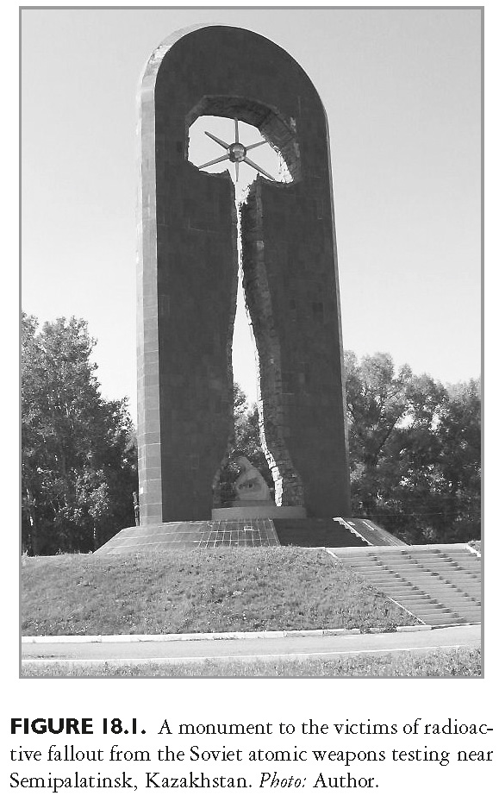
This slide is a supplement to A Geography of Russia and Its Neighbors, Second Edition by Mikhail S. Blinnikov. Copyright © 2021 The Guilford Press.

Slide 8
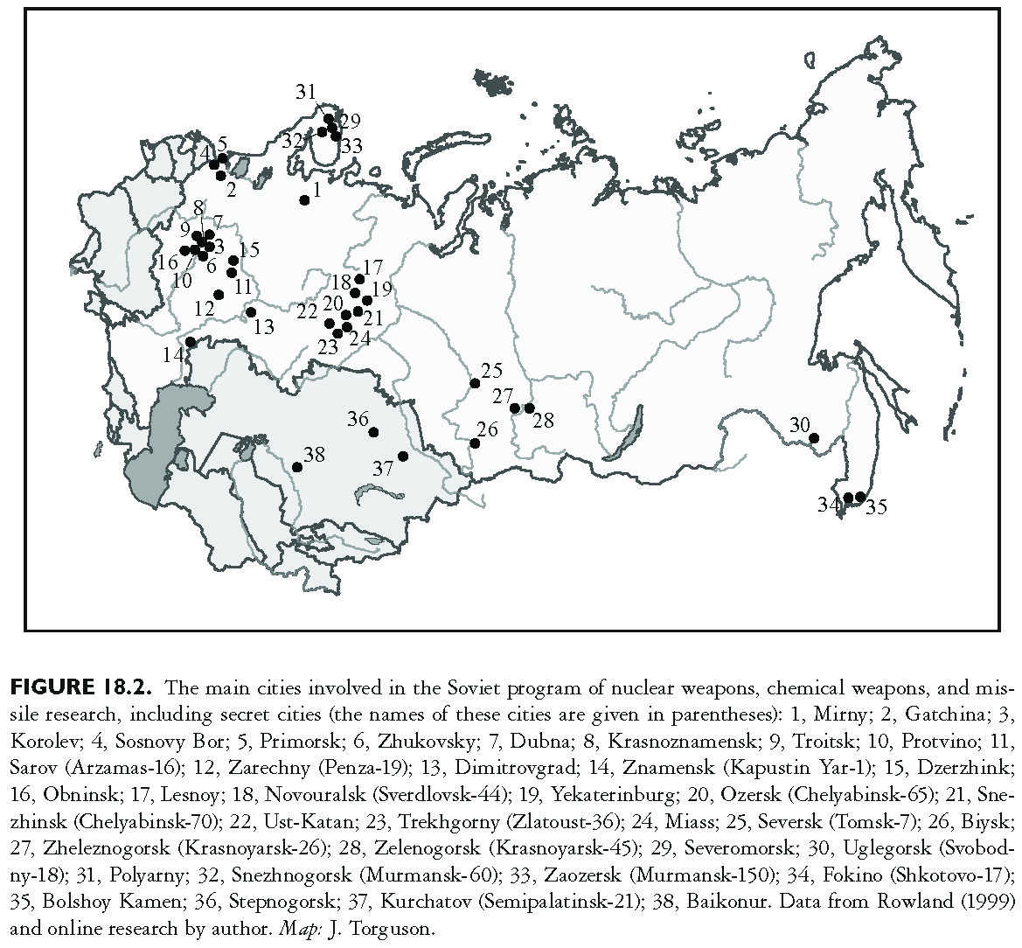
This slide is a supplement to A Geography of Russia and Its Neighbors, Second Edition by Mikhail S. Blinnikov. Copyright © 2021 The Guilford Press.

Slide 9
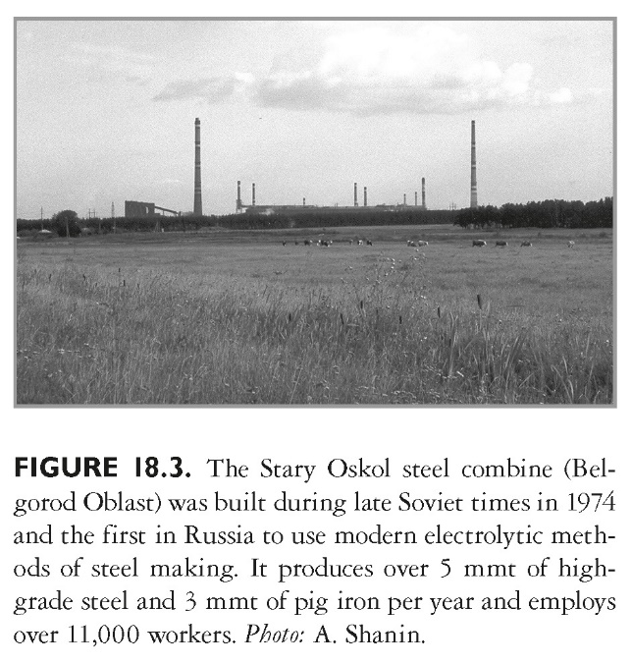
This slide is a supplement to A Geography of Russia and Its Neighbors, Second Edition by Mikhail S. Blinnikov. Copyright © 2021 The Guilford Press.

Slide 10
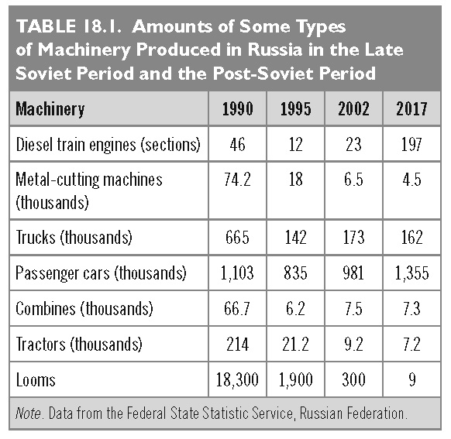
This slide is a supplement to A Geography of Russia and Its Neighbors, Second Edition by Mikhail S. Blinnikov. Copyright © 2021 The Guilford Press.

Slide 11
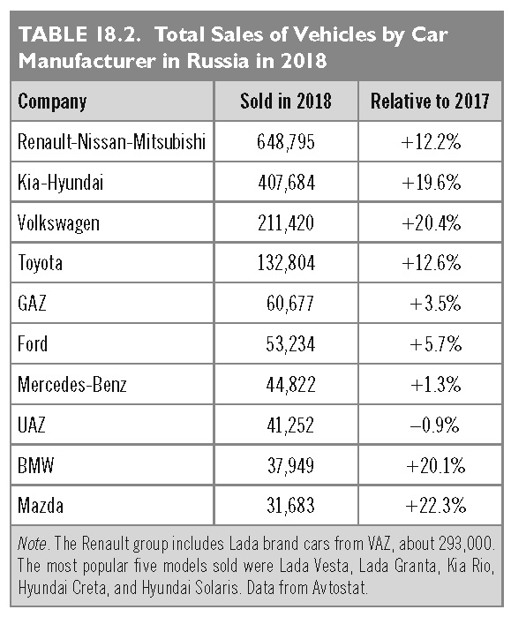
This slide is a supplement to A Geography of Russia and Its Neighbors, Second Edition by Mikhail S. Blinnikov. Copyright © 2021 The Guilford Press.

Slide 12
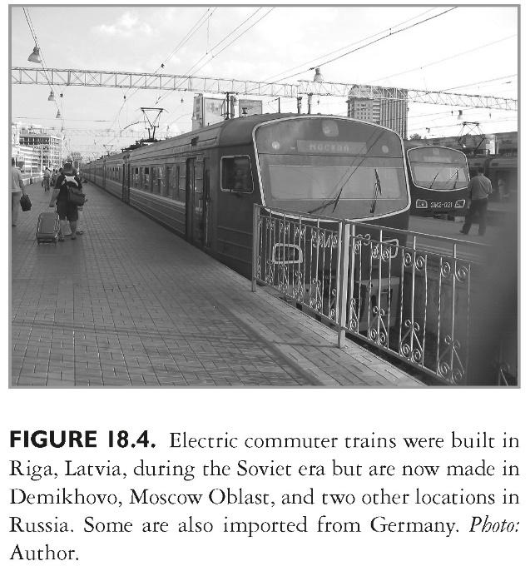
This slide is a supplement to A Geography of Russia and Its Neighbors, Second Edition by Mikhail S. Blinnikov. Copyright © 2021 The Guilford Press.

Slide 13
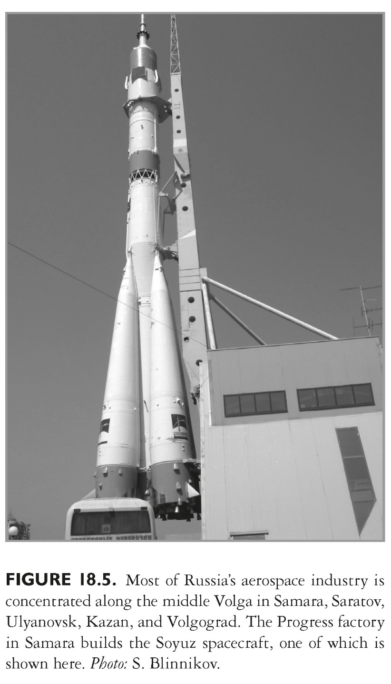
This slide is a supplement to A Geography of Russia and Its Neighbors, Second Edition by Mikhail S. Blinnikov. Copyright © 2021 The Guilford Press.

Slide 14
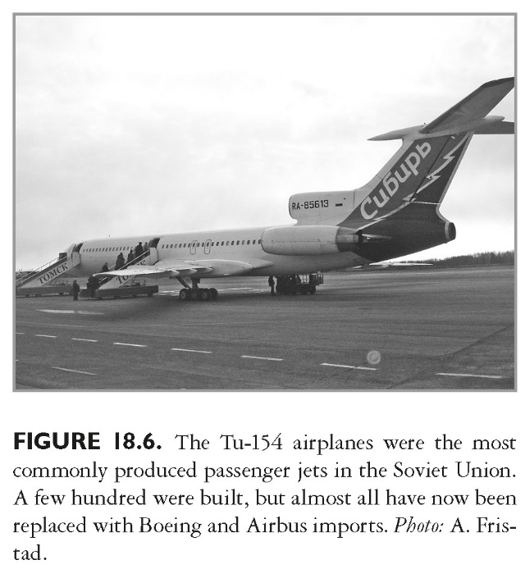
This slide is a supplement to A Geography of Russia and Its Neighbors, Second Edition by Mikhail S. Blinnikov. Copyright © 2021 The Guilford Press.

Slide 15
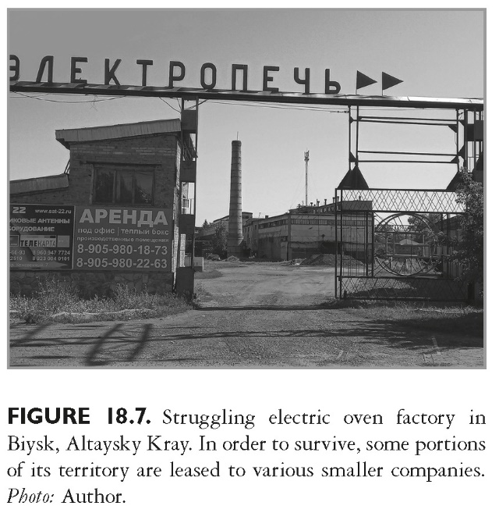
This slide is a supplement to A Geography of Russia and Its Neighbors, Second Edition by Mikhail S. Blinnikov. Copyright © 2021 The Guilford Press.

Slide 16
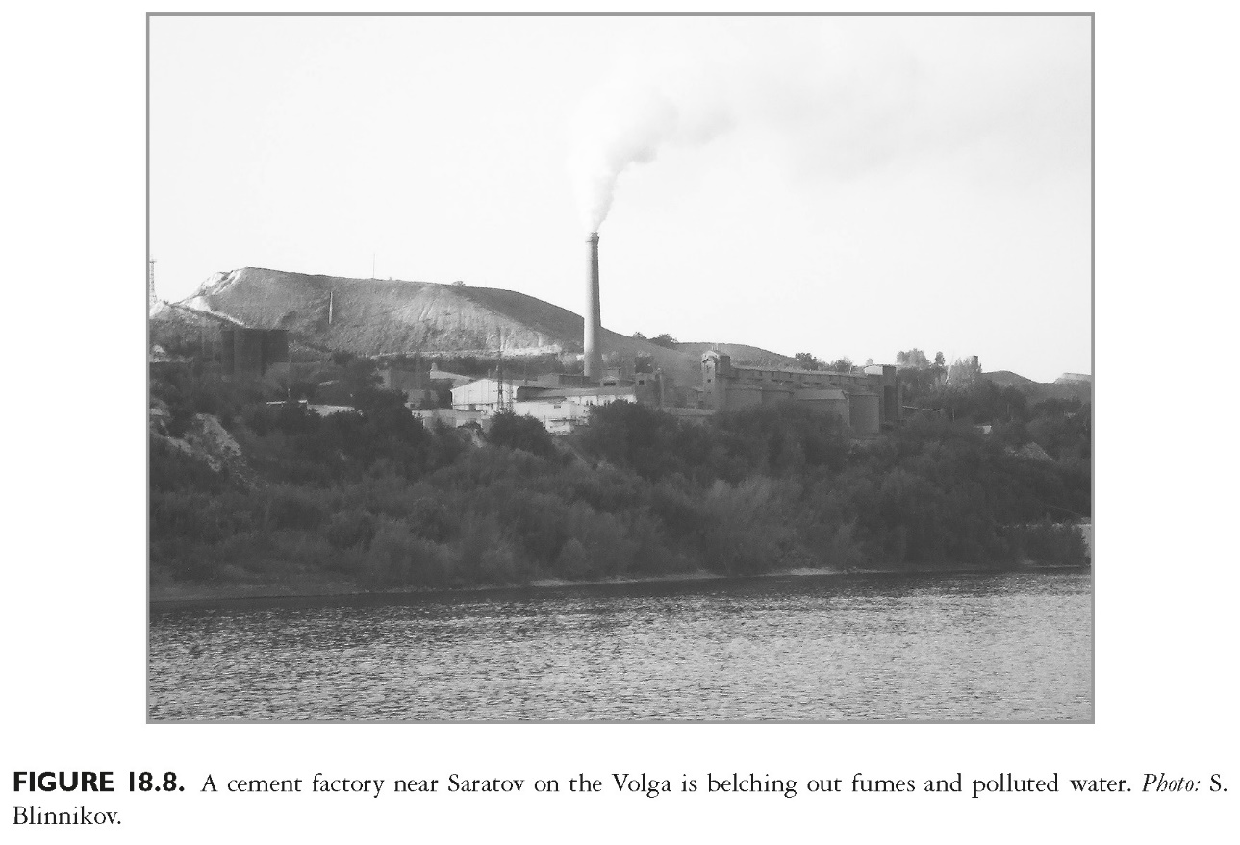
This slide is a supplement to A Geography of Russia and Its Neighbors, Second Edition by Mikhail S. Blinnikov. Copyright © 2021 The Guilford Press.

