Slide 1
This slide is a supplement to A Geography of Russia and Its Neighbors, Second Edition by Mikhail S. Blinnikov. Copyright © 2021 The Guilford Press.
Chapter 19. Light Industry and Consumer Goods
Light industry is struggling
Some of the worst hit sectors are textiles, clothing, and shoe manufacturing
Food processing and construction are booming

Slide 2
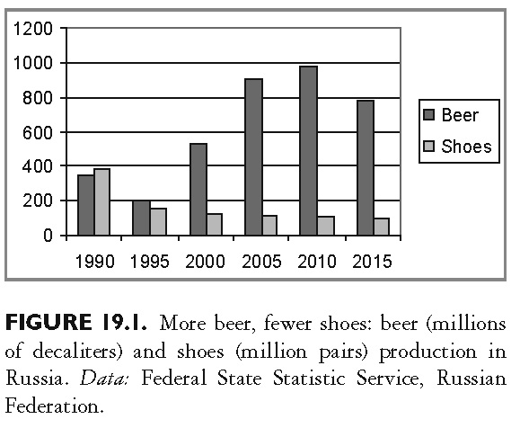
This slide is a supplement to A Geography of Russia and Its Neighbors, Second Edition by Mikhail S. Blinnikov. Copyright © 2021 The Guilford Press.

Slide 3
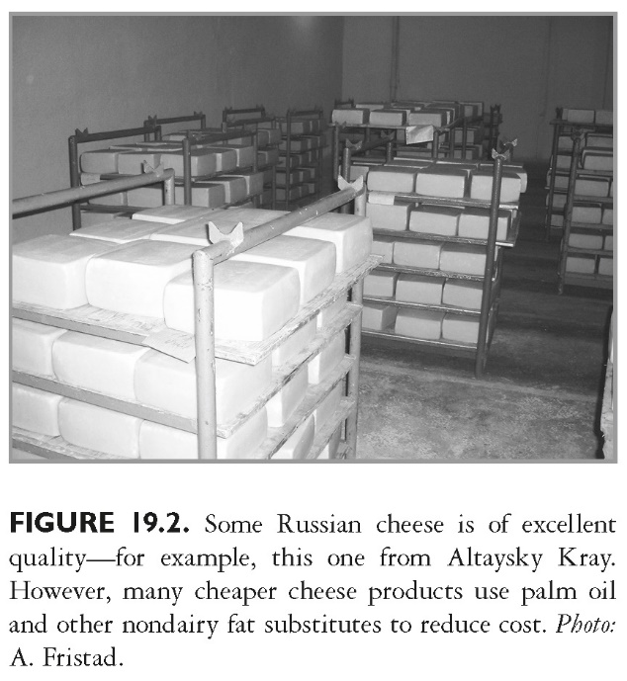
This slide is a supplement to A Geography of Russia and Its Neighbors, Second Edition by Mikhail S. Blinnikov. Copyright © 2021 The Guilford Press.

Slide 4
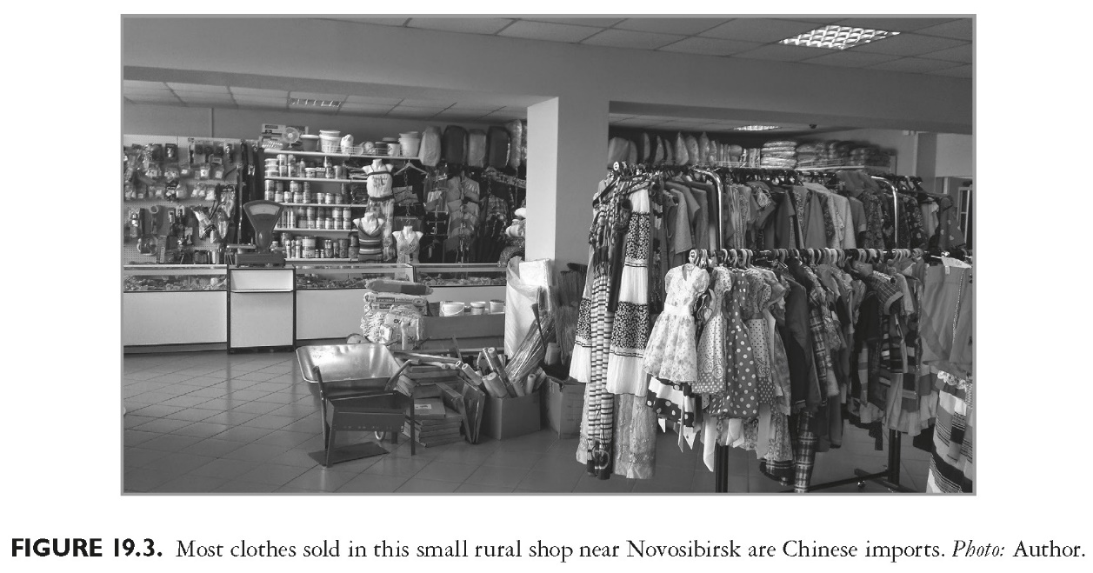
This slide is a supplement to A Geography of Russia and Its Neighbors, Second Edition by Mikhail S. Blinnikov. Copyright © 2021 The Guilford Press.

Slide 5
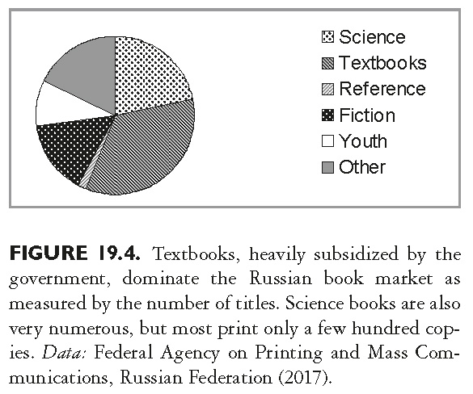
This slide is a supplement to A Geography of Russia and Its Neighbors, Second Edition by Mikhail S. Blinnikov. Copyright © 2021 The Guilford Press.

Slide 6
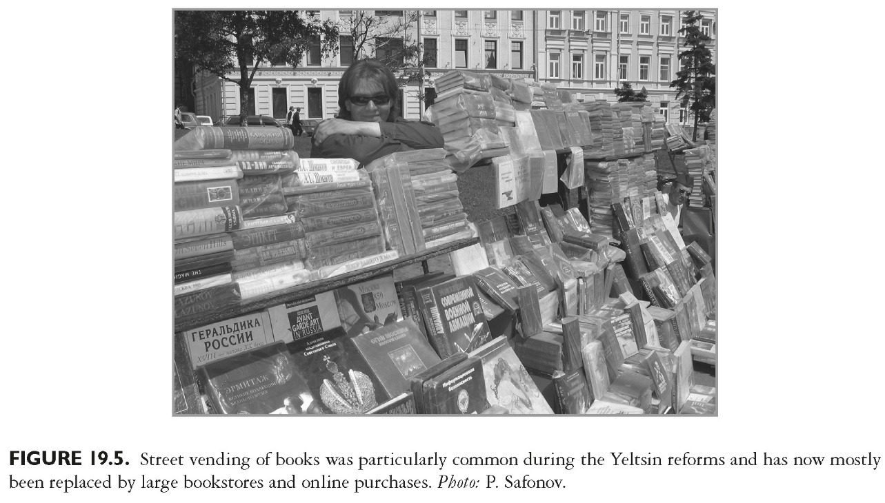
This slide is a supplement to A Geography of Russia and Its Neighbors, Second Edition by Mikhail S. Blinnikov. Copyright © 2021 The Guilford Press.

